Slide 1
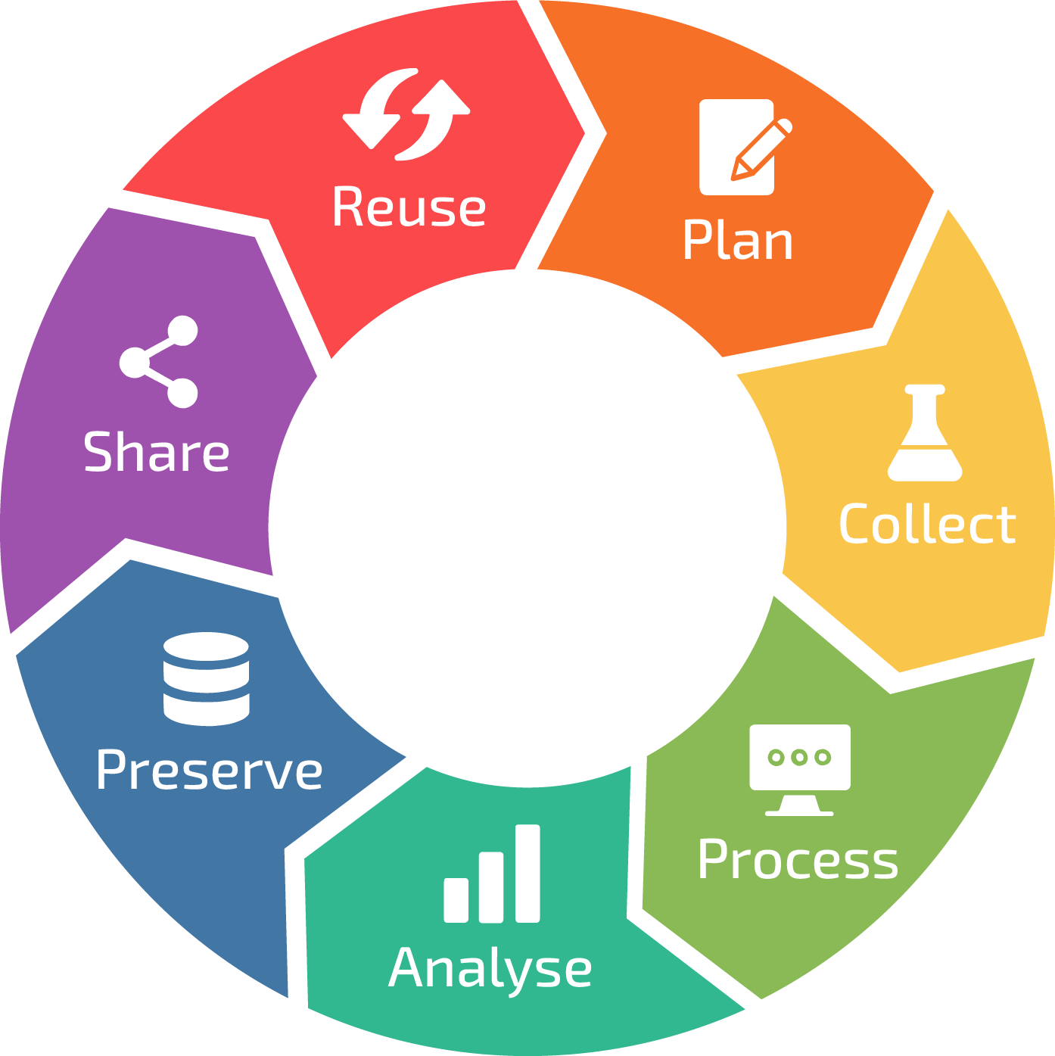
ML Health
TriCARE
Set Project Predict Objectives
DigiHealth
Design Predict System parameters.
Medic
Manufacture Predict sensors.
Data Types
Project WORD documentation
Project plans – VISIO etc.
Data Types
ML model file
ML Heath + DigiHealth to update ML model based on historical accuracy and Patient health (from survey data).
Data Types
Text
XL – accuracy score
XML Sensor data
Research Dashboard -PPT/BI reports
Share
Alert Triage action to TriCare.
TriCare share ML accuracy in Triage recommendations presented to Data Scientists in ML Health.
Alert Medic of faulty sensor.
Present research dashboard to ML Health + TriCARE to assess project effectiveness based on research.
Capture
Patient profile data from TriCare for ML Health + DigiHealth modelling.
Patient Sensor Data.
ML Health Researcher data (post interview).
Sensor diagnostic data.
Data Types
Survey questions
Sensor metrics;
BP
Activity
Blood glucose
XML sensor files
Predict
Project
Data Types
Relational DB store
XML sensor data
Store
Patient
Sensor data.
Dashboard reports.
Actual Triage Outcomes.
General health (from interview data).
Nurse/ML Triage recommendations
Sensor diagnostic data.
Process
Patient profile data to allow ML Health + DigiHealth build Triage ML model.
Patient sensor data reviewed by Nurse/ML.
Assess Sensor diagnostic data.
Collate ML Health Researcher data.
Data Types
XL, CSV data files
On screen text (patient dashboard)
Survey data
Nurse/ML derive Patient Triage recommendation.
ML Health + DigiHealth evaluate Triage ML model accuracy score.
System determines if sensor faulty.
Format research data analysis.
Data Types
Text
Numerical score
XML sensor data
XL/PPT/BI output (research)

